Slide 1
AS91896(2.7) & AS91887(2.8) Documentation
Josh Currie-Cook

Slide 2
[Overtype this with your program name]
Link to GitHub Repository: Joepapa101/2.7---2.8-Assessment (github.com)
Links to Trello board / project management tools: Monster Card Decomposition | Trello
Link to final version of your program:

Slide 3
Explain relevant Implications:
Additional rows can be added by clicking in the last cell and then using the Tab key
Relevant implication | Describe the implication and give an example
Useability | The program needs to be usable, most people use a user interface however most basic python programs limit the user interface to a command console. Because of this, instructions need to be given, and it needs to be easy to use. For example, all of the menu functions have been named appropriately.
Practicality | For the program to be practical, it needs to have clearness so that the user knows what to do. For example, the functions need to actually exist and work well.
Accessibility | The program needs to be easy to access and use by anyone. For that to happen, it needs to be easy to follow and use, as much as command lines look daunting to most people. For example, to navigate around the program, it needs to be easy, and be clear and concise.
A bug free expericence | A bug free experience is important, meaning the program wont break down randomly. For example, if the user enters the wrong answer, the program won’t break down.
Notes:
Additional rows can be added by clicking in the last cell and then using the Tab key

Slide 4
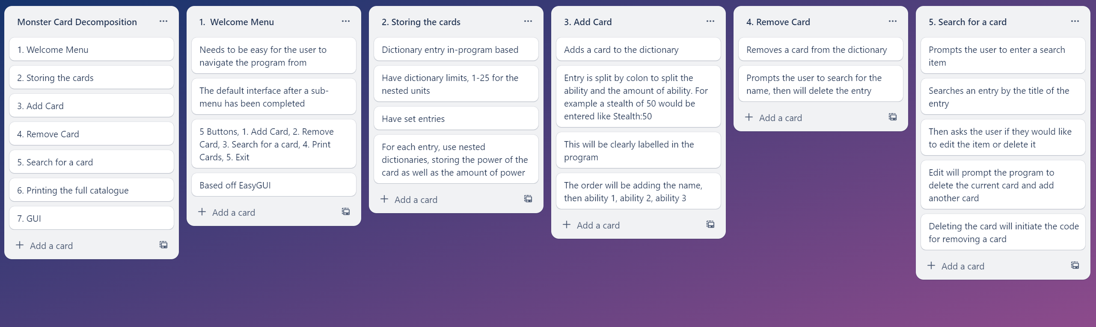
Decomposition:
Paste screenshots of your initial Trello board / task decomposition on this slide. If you have a long list, you might need to break it up into several slides.
Notes:
Paste screenshots of your initial Trello board / task decomposition on this slide. If you have a long list, you might need to break it up into several slides.

Slide 5
[Component name] (Trello screenshot)

Slide 6
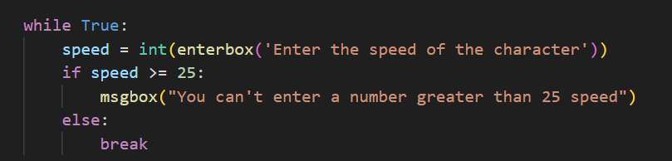
Add entry- Test Plan
Additional rows can be added by clicking in the last cell and then using the Tab key
Test Cases – input | Expected output
A number below 25 and above zero | A new item in the dictionary
A number above 25 | The program to throw an error and ask the user to re-enter the number
Notes:
Additional rows can be added by clicking in the last cell and then using the Tab key

Slide 7
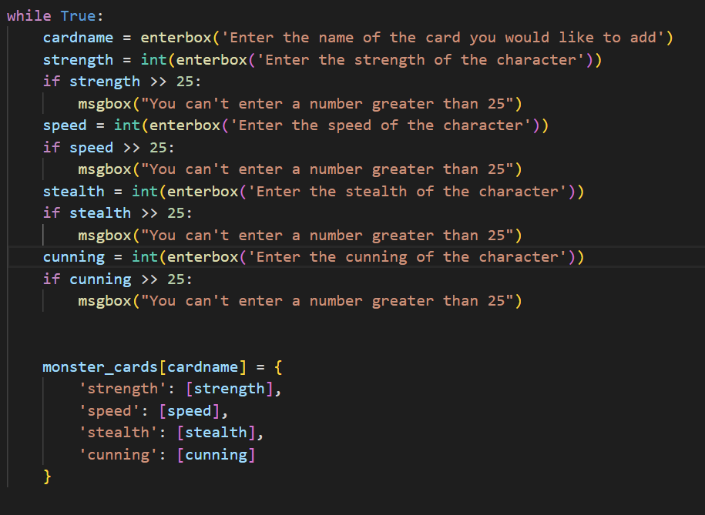
Add item : Trialling
What I wanted the code to do is throw an error everytime the user entered a number bigger than 25. I started off by using the >> operater because I thought that’s how you were supposed to phrase it. To my surprise, the program threw up no errors, no matter how big I made the numbers
NOTE: Trialling needs to happen for at least 2 of your components but is not necessary for ALL components.
Trialling is not the same as testing. Trialling is about finding different ways of building the same component. Show evidence of your trialling here. Select one of your trials for further development and give reasons for your choice.
Notes:
NOTE: Trialling needs to happen for at least 2 of your components but is not necessary for ALL components.
Trialling is not the same as testing. Trialling is about finding different ways of building the same component. Show evidence of your trialling here. Select one of your trials for further development and give reasons for your choice.

Slide 8
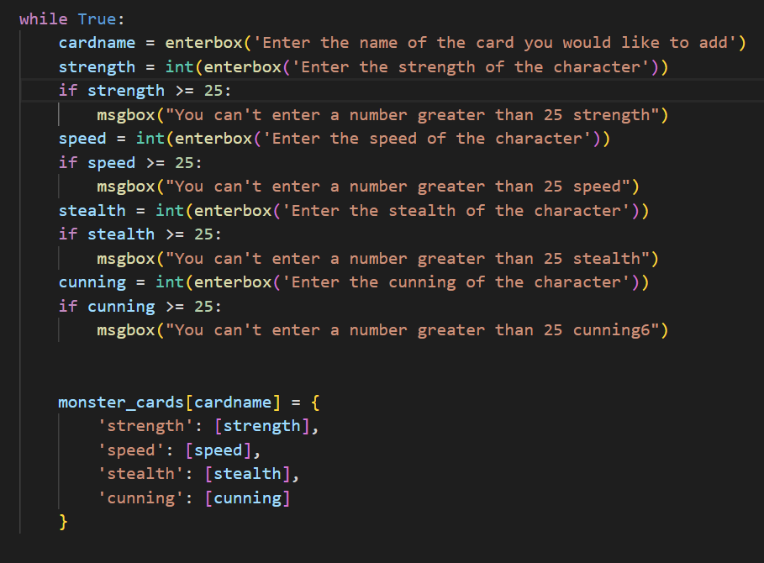
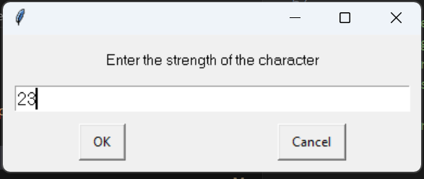
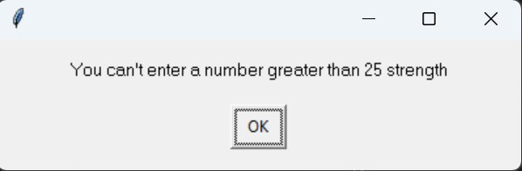
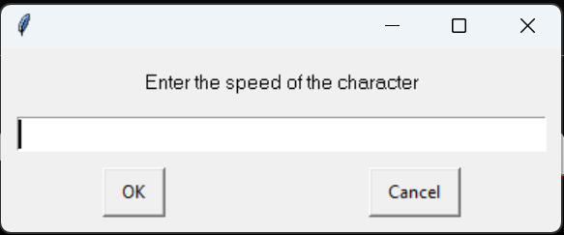
Add item - Trialling
I added an above-equal sign and that fixed the problem, however it was not letting the user go back and edit their wrong number

Slide 9
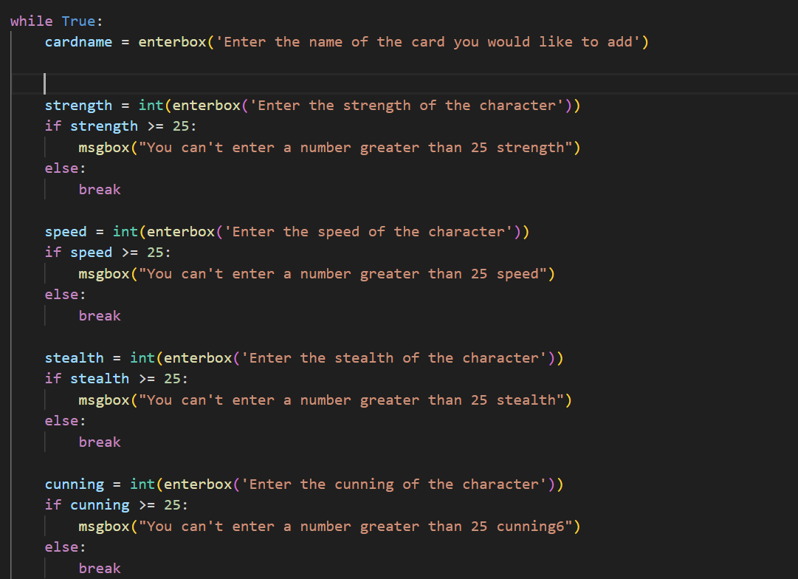
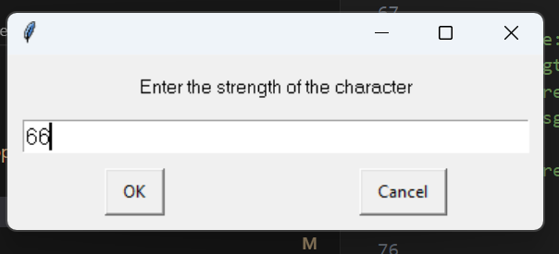
Add item - Trialling
I also trialled using an else: command to try and make sure it would go back to the previous command, however the same result occurred, and if I entered a number above 25 for ‘strength,’ it would say I had the wrong number and carry on to ‘speed’

Slide 10
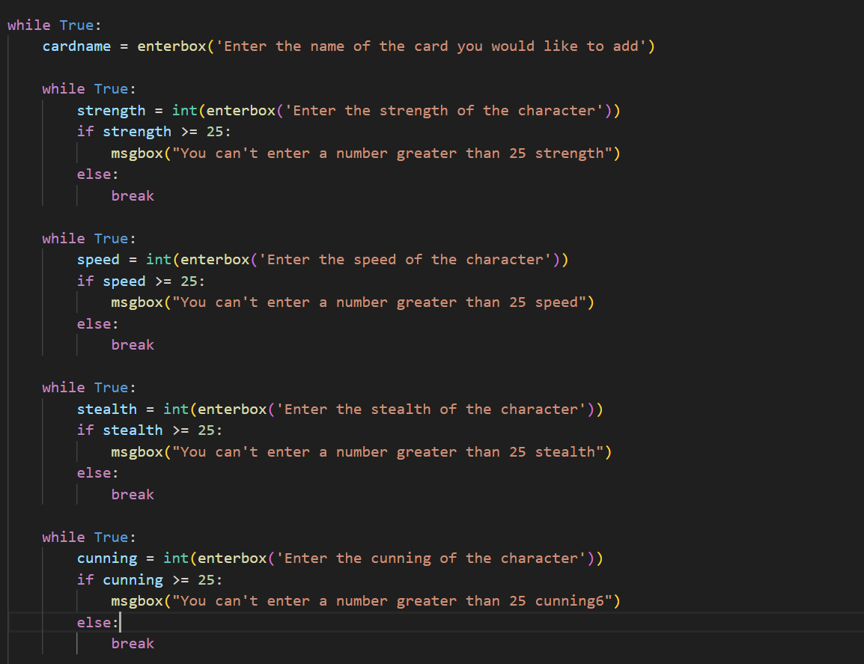
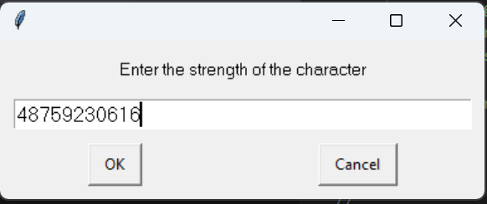
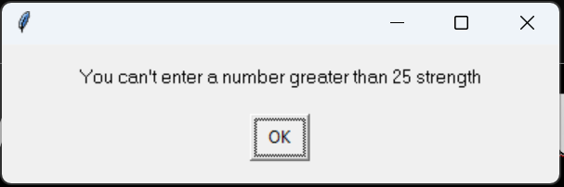
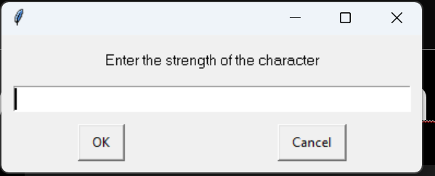
Add item - Trialling
In version 3 of the program, I added a ‘while true’ loop to each individual ability. The outcome was exactly as intended, with the program spitting out an error to the user saying the number cannot be greater than 25, and repeating the command just prompeted instead of going to the next one

Slide 12
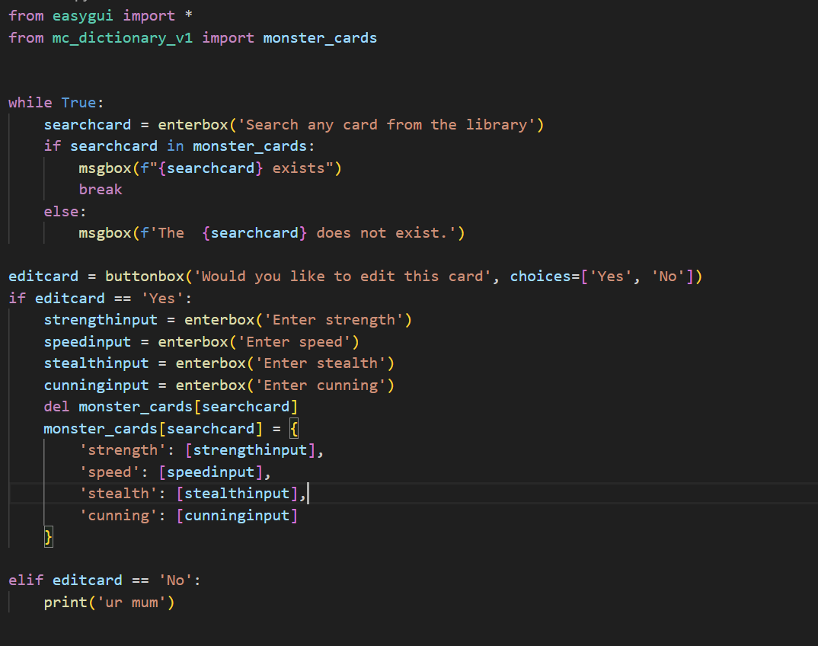
Search for item – Trialing (v.1)
To start off with, for searching for an item, I got the searchcard variable to define the user’s input for the search query. I then got an if loop to confirm if the item the user searched was in the dictionary
For the editcard section, I got the user’s input of the now determined ‘correct card’ to delete the dictionary entry, and for the user to enter the speed, stealth and strength again to effectively delete the dictionary entry and create a new one with the same name however the user appended abilities.

Slide 13
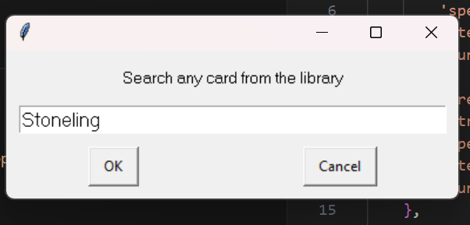
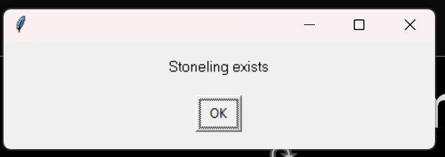
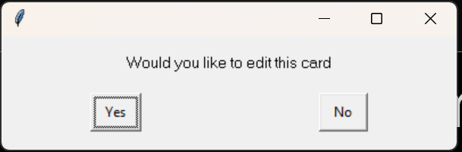
Search for item - Trialling
Before edit
After edit

Slide 14
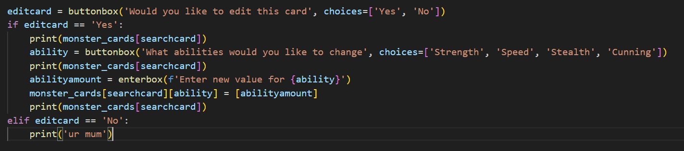
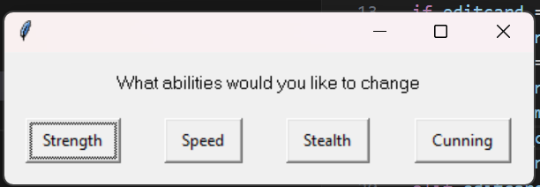
Search for item – Trialling (v3)
To make the edit process more intuitive, instead of deleting the whole list and creating it again, therefore getting the user to input all of the values again, I made a process where an easygui prompt will give the user an option on what specific ability to edit, instead of redoing all of the abilities.
However the buttonbox was creating a new entry called ‘Speed’ rather than adding an entry to the existing ‘speed.’ However everything else was working as intended

Slide 15
Search for item - Trialling
Adding a .lower to the end of ability solved the problem

Slide 16
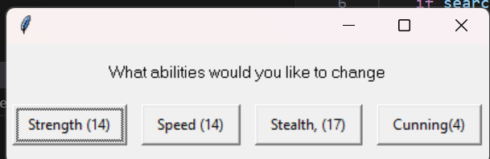
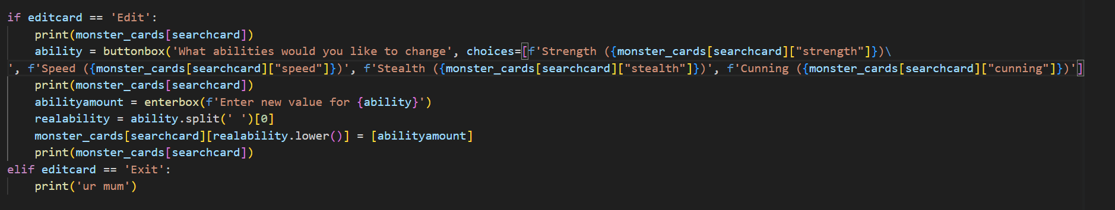
Search for item – Trialling (v4)
In version 4 of the program component, I created the ability selection buttons to have the amount of ability beside them
I achieved this by first splitting the ability and the current number using an ability.split command. That split the ability from the associated number. The lower case made the capital letter at the start of the word lower.

Slide 17
Search for item - Trialling

Slide 19
[Component name]: Testing
You must show the results of testing. For each component, include a screenshot proving it works. You can also include notes about each test.
Notes:
You must show the results of testing. For each component, include a screenshot proving it works. You can also include notes about each test.

Slide 20
Assembled Outcome Testing:
Show testing for your assembled outcome below. This should include a test plan followed by screenshot proof.
Notes:
Show testing for your assembled outcome below. This should include a test plan followed by screenshot proof.

Slide 21
Address relevant Implications:
Relevant implication | Explain how your final outcome addresses each implication

Slide 22
Version Control Evidence:
Your version control evidence should go here. This could be in the form of screenshots (both of your GitHub repository as well as your local project folder) as evidence of your incremental development.
Notes:
Your version control evidence should go here. This could be in the form of screenshots (both of your GitHub repository as well as your local project folder) as evidence of your incremental development.

Slide 23
Final Discussion:
Discuss how the information from planning, testing and trialling of components assisted in the development of a high-quality outcome.
Notes:
Discuss how the information from planning, testing and trialling of components assisted in the development of a high-quality outcome.

